Slide 1
Chapter 3

Slide 2
Objectives

Slide 3
Objectives (continued)

Slide 4
The relational operators

Slide 5
Conditional expressions

Slide 6
The syntax of the global isNaN method

Slide 7
The logical operators in order of precedence

Slide 8
Conditional expressions with logical operators

Slide 9
Terms

Slide 10
The syntax of the if statement

Slide 11
An if statement with else if and else clauses

Slide 12
An if statement with a compound conditional expression

Slide 13
How to test a Boolean variable

Slide 14
The syntax of a while loop

Slide 15
The syntax of a do-while loop

Slide 16
A do-while loop that gets a user entry until it is a number

Slide 17
The syntax of a for statement

Slide 18
A for loop that calculates the future value of an investment

Slide 19
Terms

Slide 20
Two of the dialog boxes for the Miles Per Gallon application

Slide 21
The JavaScript for the MPG application

Slide 22
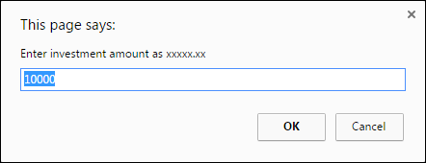
The first of three prompt dialog boxes for the Future Value application

Slide 23
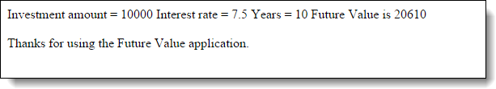
The result in a browser

Slide 24
The HTML and JavaScript for the FV app

Slide 25
The HTML and JavaScript (continued)

Slide 26
The dialog boxes for the Test Scores app

Slide 27
The dialog boxes for the Test Scores app (cont.)

Slide 28
The JavaScript in the head section of the HTML file

Slide 29
The syntax for creating an array

Slide 30
The syntax for referring to an element of an array

Slide 31
How to add values to an array

Slide 32
The syntax for getting the length property of an array

Slide 33
Code that puts the number 1 through 10 into an array

Slide 34
Code that puts four totals in an array

Slide 35
Code that displays the totals and the sum

Slide 36
Terms

Slide 37
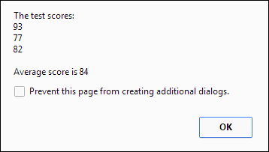
The result of the Test Scores app with an array

Slide 38
The JavaScript for the enhanced app

Slide 39
The JavaScript (continued)

Slide 40
Exercise 3-1 Enhance the Future Value app

Slide 41
Exercise 3-2 Enhance the Test Scores app

Slide 42
Extra 3-1 Enhance the Fahrenheit to Celsius application

Slide 43
Extra 3-2 Convert number grades to letters

Slide 44
Extra 3-2 (continued)

Slide 45
Extra 3-3 Create a Sum of Numbers application

Slide 46
Extra 3-4 Use a sales array

Slide 47
Short 3-1 Enhance the Future Value app

